Slide 1
Drum Synthesizer With JavaScript
Final Project CSD122
Martin Penberthy

Slide 2
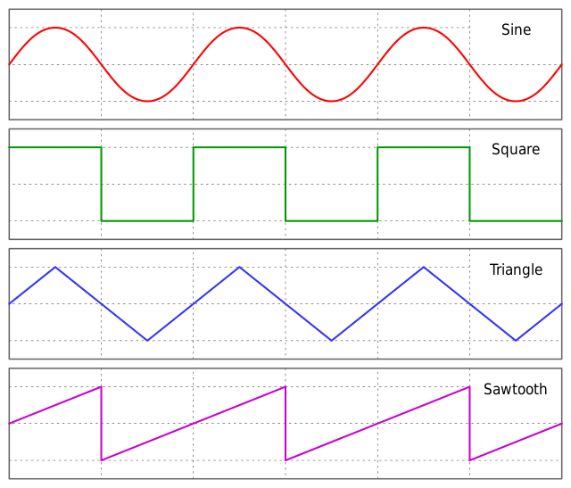
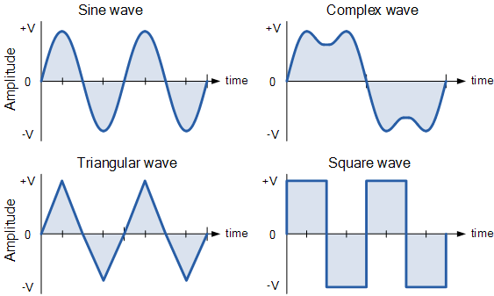
How synthesizers work
Generate sounds from mathematical functions
Basic waveforms: triangle, sawtooth, sine, square
Each waveform has unique harmonic content
Building blocks of more complex sounds
Fourier’s theorem:
“...periodic waveform can be expressed as the
sum of an infinite set of sine waves.
The frequencies of these sine waves must be integer
multiples of some fundamental frequency.”

Slide 3
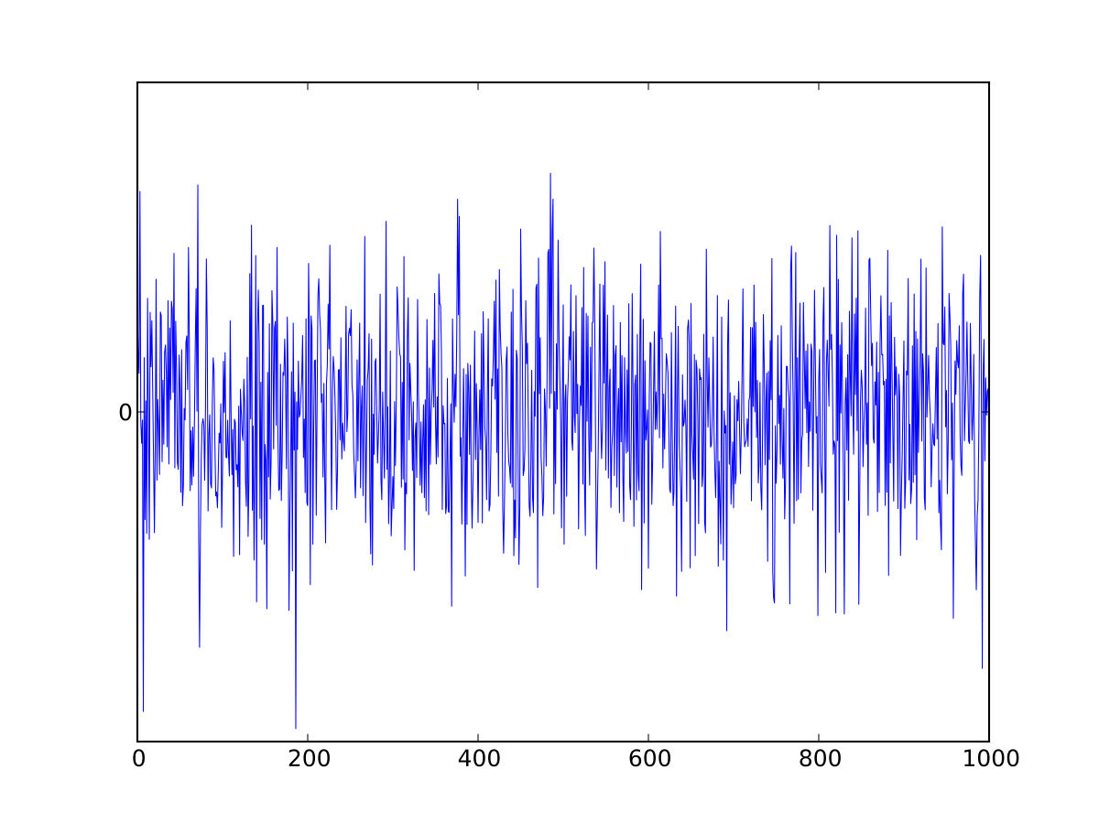
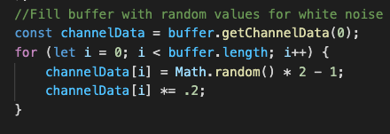
How synthesizers work cont.
Noise is crucial for generating realistic drum sounds
White noise is a series of randomly generated values which is output as audio

Slide 4
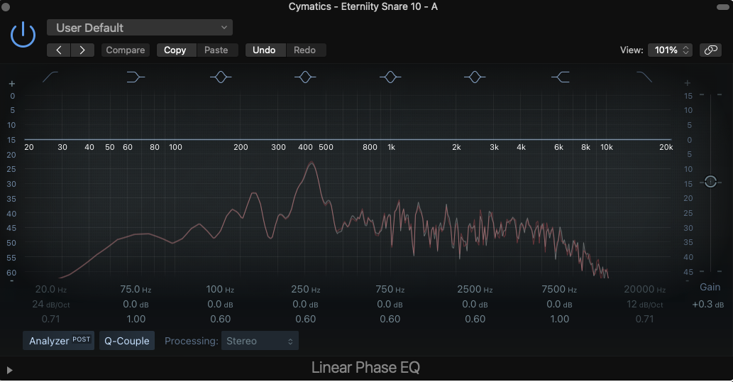
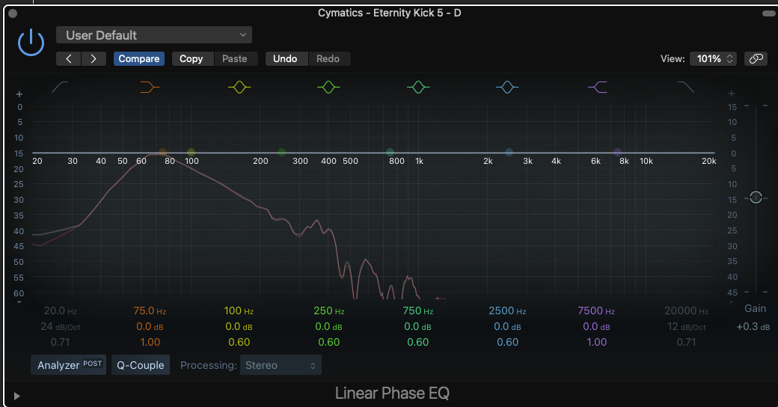
Generating Drums
Every drum sound has a fundamental frequency, electronically reproduced as a sine or triangle wave
To imitate tonal properties of drums, the pitch of this fundamental can be rapidly changed
White noise is also introduced to represent the high frequency content of a snare drum
SNARE
KICK
Fundamental
frequency
Noise
Fundamental
frequency

Slide 5
How I implemented my drum machine
Web Audio API:
“The Web Audio API provides a powerful and versatile system for controlling audio on the Web, allowing developers to choose audio sources, add effects to audio, create audio visualizations, apply spatial effects (such as panning) and much more.”
https://developer.mozilla.org/en-US/docs/Web/API/Web_Audio_API
White noise, snare and kick

Slide 6
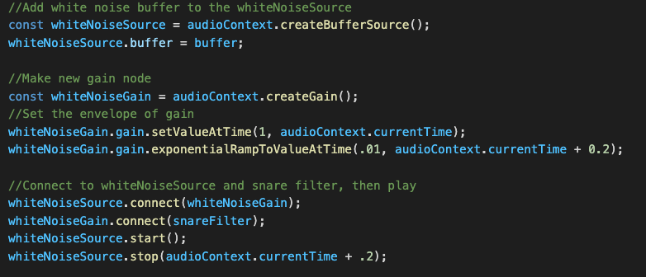
How I implemented a snare drum
Implement white noise element of sound

Slide 7
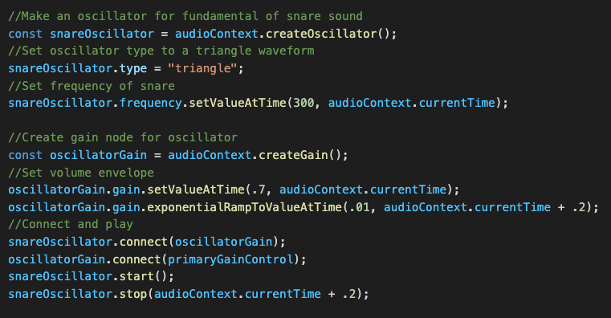
How I implemented a snare drum cont.
Implement fundamental frequency of snare

